Slide 1
Technology for Success: Computer Concepts

Slide 2
Module 5
Software and Apps

Slide 3
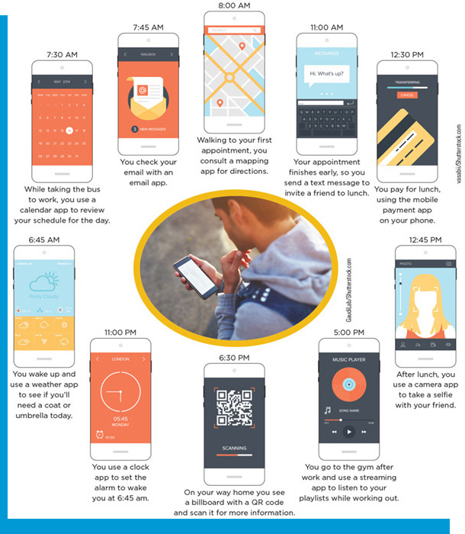
Lesson Objectives
Explain how apps are used in daily computing life
Use common features of productivity apps

Slide 4
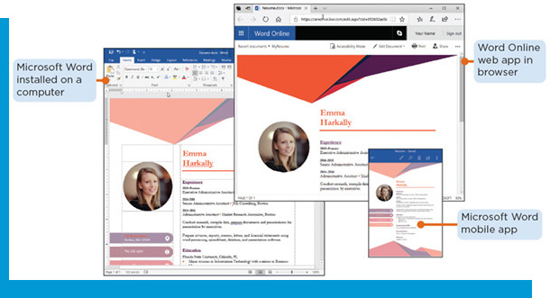
How Apps are Used in Daily Computing Life
Describe the purpose of each key type of app
Explain the differences between native and web apps
Summarize current trends in app development

Slide 5
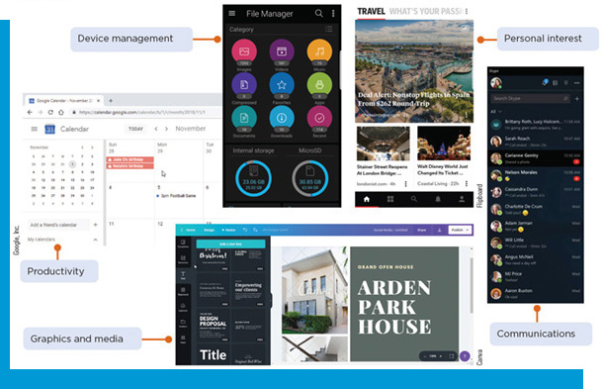
The Purpose of Each Key Type of App (1 of 4)
Application software: programs that help you perform specific tasks when using your computer or device
Productivity apps: allow one to create documents for business and personal use Graphics and media apps: allow one to interact with digital media
Personal interest apps: give one tools to pursue interests
Communications apps: provide tools for sharing or receiving information
Device management apps: provide tools for maintaining a computer or device

Slide 6
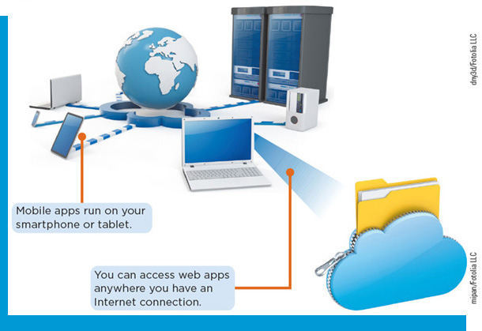
The Purpose of Each Key Type of App (2 of 4)
Types of Apps
Local applications: installed on the computer’s hard drive
Portable apps: run from removable storage, such as an external hard drive or from the cloud
Web apps: programs accessed over the Internet, in a browser, or on a mobile device
Mobile apps: apps that you access on a smartphone or tablet

Slide 7
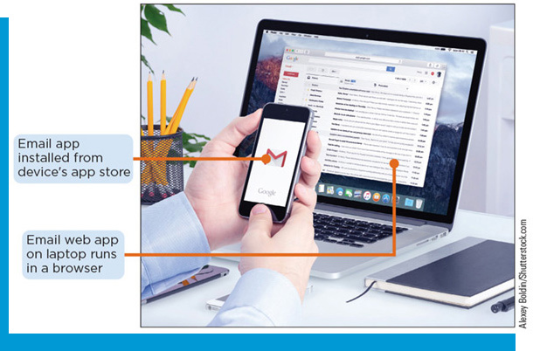
The Purpose of Each Key Type of App (3 of 4)
App Features
Represented on the desktop by an icon or tile
Can be run by double-clicking or tapping
Open in a window
Have menus that give options to access different features of the program
Have buttons to click or tap to give commands or perform actions
Some are available as both a web and a mobile app and can synchronize data

Slide 8
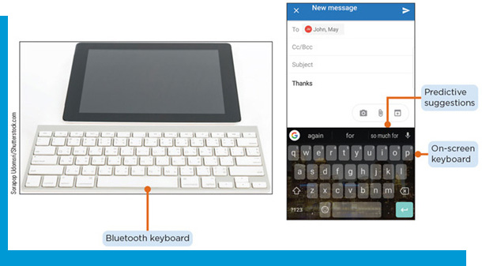
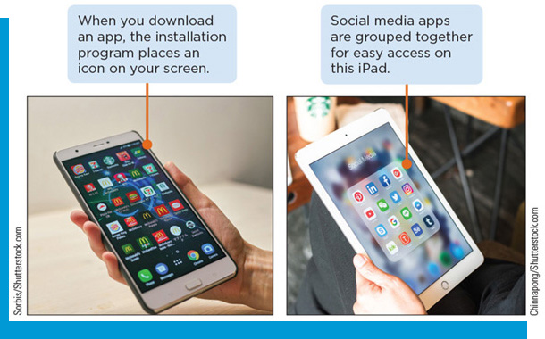
The Purpose of Each Key Type of App (4 of 4)
Mobile Apps
Touch the screen to interact with mobile apps
Use an on-screen keyboard to enter information
Many mobile devices come preinstalled with apps
You can organize apps into groups by category
Apps are represented by icons on your screen
An app store is used to find and download apps

Slide 9
The Differences Between Native and Web Apps (1 of 3)
Native Apps
An app written for a specific operating system and installed on a computer or mobile device
Can take advantage of specific features of the devices on which they are installed
Many require an Internet connection to provide full functionality. Some can run offline and will store information on your device until they can synchronize with the cloud.

Slide 10
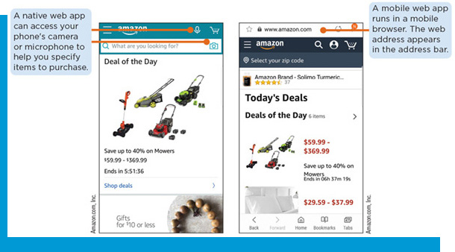
The Differences Between Native and Web Apps (2 of 3)
Web Apps
Accessed by visiting a website in a browser
A mobile app is a web app that runs on a mobile device
Mobile web apps often have a responsive design
Many developers prefer web apps since they run on all devices
Some apps are available both as native and web apps

Slide 11
The Differences Between Native and Web Apps (3 of 3)
Pros and Cons of Mobile Apps
Table 5-2: Pros and cons of mobile apps
Pros | Cons
Mobile web apps can be created quickly compared to native apps. | Mobile web apps are not as fast and have fewer features than native web apps or desktop apps.
You can access your information on the go. | Poorly designed apps can turn people away.
Voice input and smart on-screen keyboard simplify interactions. | Typing using a small on-screen keyboard can be cumbersome.

Slide 12
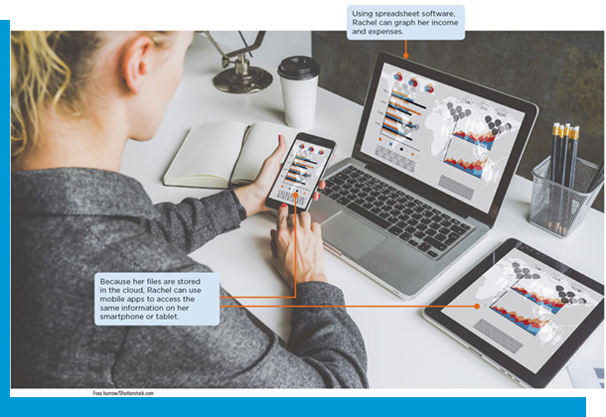
Current Trends in App Development
Mobile first design
Developers build apps to work on mobile devices first because they have more restrictions
Requires designers to streamline how people interact with their apps by placing content first and providing a simplified user experience
Developers use cross-platform development tools
Mobile commerce, or m-commerce, apps let you use your mobile device to make online purchases of goods and services

Slide 13
Use Common Features of Productivity Apps (1 of 2)
Understand the features of common productivity suites
Use word processing software for basic word processing functions
Use spreadsheet software to manage basic workbooks
Use presentation software to create and share basic presentations

Slide 14
Use Common Features of Productivity Apps (2 of 2)
Use database software to manage basic databases
Use graphics software

Slide 15
The Features of Common Productivity Suites (1 of 2)
Productivity Suite
Versions to install on a computer, mobile device, or run in the cloud in a browser
Web and mobile versions are often simpler and contain the most basic and popular features
Some are free, and some require you to purchase a license or subscription
Storing documents in the cloud allows for collaboration

Slide 16
The Features of Common Productivity Suites (2 of 2)
Popular Productivity Suites
Table 5-3: Popular productivity suites
 | Microsoft Office | Apple iWork | G Suite | OpenOffice
Operating system supported | Windows, macOS or web apps | macOS, iOS, or web apps | ChromeOS or web apps | Windows, Linux, macOS
Word processor | Microsoft Word | Pages | Google Docs | Writer
Spreadsheet | Microsoft Excel | Numbers | Google Sheets | Calc
Presentation | Microsoft PowerPoint | Keynote | Google Slides | Impress
Database | Microsoft Access |  |  | Base
Email | Microsoft Outlook | Apple Mail | Gmail
Online version | Office Online | iWork for iCloud | G Suite
Cloud storage | Microsoft OneDrive | iCloud | Google Drive

Slide 17
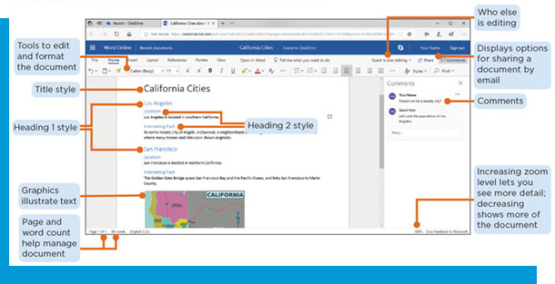
Word Processing Software (1 of 5)
Key Features
Create documents, a collection of one or more pages
When you open the program, a blank document appears
The screen displays an insertion point and scroll bars
Offers a variety of options to create and format the document
Document management tools protect and organize files

Slide 18
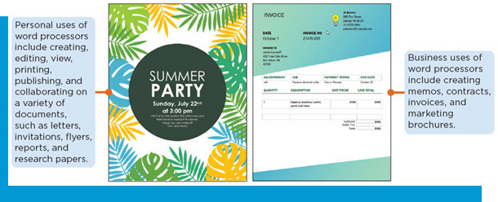
Word Processing Software (2 of 5)
Personal and Professional Uses
Table 5-4: Uses of word processing
Who uses word processing | To create
Business executives, office workers, medical professionals, politicians | Agendas, memos, contracts, proposals, reports, letters, email, newsletters, personalized bulk mailings and labels
Personal users | Letters, greeting cards, notes, event flyers, check lists
Students | Essays, reports, stories, resumes, notes
Conference promoters and event planners | Business cards, post cards, invitations, conference tent cards, name tags, gift tags, stickers
Web designers | Documents for publishing to the web after converting them to HTML

Slide 19
Word Processing Software (3 of 5)
Formatting
Format text by changing font type, size, style, color, and special effects
Specify a document’s margins and the page orientation
Specify styles for a document’s title, headings, paragraphs, quotes, and more
Many productivity suites offer built-in templates for creating different kinds of documents

Slide 20
Word Processing Software (4 of 5)
Table 5-6: Additional document formatting options
Use this features | When you want to
Alignment | Align paragraphs at the left margin, right margin, or center of the page
Graphics | Add photos, pictures, logos, charts, or screenshots to your document to add visual appeal
Headers and Footers | Display information such as a document title, author’s name, or page number at the top or bottom of each page
Hyperlinks | Direct readers to related documents, email addresses, or websites online
Line spacing | Specify how much “white space” appears before, between, or after each line of text (measured in points)
Lists | Display a list of items preceded by numbers or a system called a bullet
Mail Merge | Create and send customized letters or email messages that are personalized with the recipient’s name and other information
Margins | Specify the region of the page where text will appear, measured from the left, right, top, and bottom edges of the page
Reference | Create a bibliography containing citations to reference articles in a research paper
Tables | Organize text in rows and columns

Slide 21
Word Processing Software (5 of 5)
Manage Documents
Offers tools to edit, share, protect, and save documents
Copy text and graphics from one document (or spreadsheet or database) to another
By storing documents in the cloud, you can share documents with several people who can read, edit, and comment on the same document at the same time
You can restrict access to a document by providing a view-only link or read-only access

Slide 22
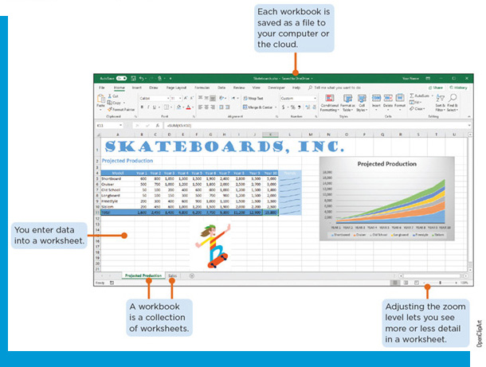
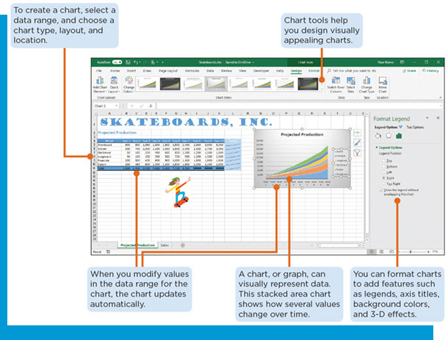
Spreadsheet Software (1 of 4)
Spreadsheets
Let you interact with numbers, charts, graphics, text, and data
Can perform calculations on data stored in a grid of cells and recalculate values automatically when the data changes
Worksheets are laid out in a grid of rows and columns; they use letters to identify each column and consecutive numbers to identify each row
A cell is the location formed by the intersection of a column and a row

Slide 23
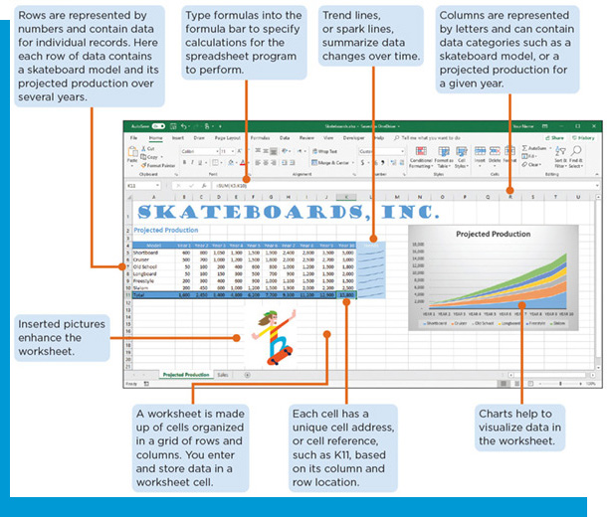
Spreadsheet Software (2 of 4)
Key Features
Formatting tools to change a worksheet’s appearance
Page layout and view features
Printing features
Web capabilities to share workbooks online, add hyperlinks, and save worksheets as webpages
Developer tools to add customized functions
Tools to analyze data

Slide 24
Spreadsheet Software (3 of 4)
Formulas and Functions
Formulas, or computation rules, calculate values using cell references, numbers, and arithmetic operators
A function: a predefined calculation
Built-in and custom functions
Argument: information necessary for a formula or function to calculate an answer
Absolute reference
Relative reference

Slide 25
Spreadsheet Software (4 of 4)
Analyze Data
Conditional formatting
Sort and filter data
Use what-if analysis
Use trendlines or sparklines and pivot tables
Automate worksheets with macros
Create charts

Slide 26
Presentation Software (1 of 6)
Key Features
Can help organize content and create professional-looking digital slide shows
Each slide has a specific layout based on its content, and each layout has predefined placeholders for these items
Display presentations in different views
Add main points as a bulleted list, graphics, or images
Provide design ideas
Spelling check, formatting, researching, sharing, and publishing online

Slide 27
Presentation Software (2 of 6)
Table 5-10: Adding content to slides
Slide content | How to enter | Provides
Text in paragraph or bulleted list | Click a placeholder and type, or copy and paste text from another file, or insert text from a document file. | Content; most programs offer a variety of bullet styles, including number and picture bullets
Graphics such as line art, photographs, clip art, drawn objects, diagrams, data tables, and screenshots | Click a content placeholder, draw directly on the slide, or copy and paste a graphic from another file. | Illustrations to convey meaning and information for the slide content
Media clips, such as video and audio, including recorded narrations | Click a content placeholder and choose a file, or insert the file directly onto a slide by recording it. | Media content to enhance a slide show
Links | Click content placeholder, copy and paste links from a website or type the link directly. | Links to another slide, another document, or a webpage
Embedded objects | Click menu commands or a content placeholder | External files in a slide
Charts | Link or embed a worksheet or chart from Excel or create a chart directly within PowerPoint | Graphic display of data to support your presentation

Slide 28
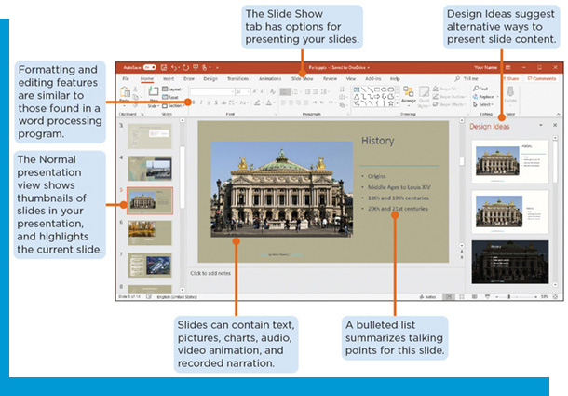
Presentation Software (3 of 6)
Formatting Features
Select a presentation design
Format text
Set a slide’s dimensions, aspect ratio, and orientation
Change text direction and align text
Resize graphics
Add SmartArt graphics that display text in predesigned configurations to convey lists, processes, and other relationships
Format charts and worksheets to present numerical data
Move, align, and group objects

Slide 29
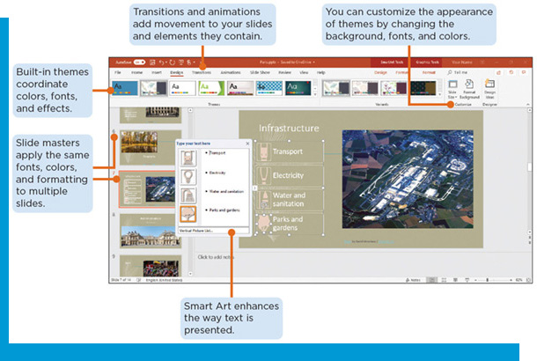
Presentation Software (4 of 6)
Use transitions and animations
Use presentation templates and slide masters
Add headers and footers
Display slides on a large monitor or project them to a screen as a slide show
Store presentations in the cloud
Share by copying the HTML embed code provided by the presentation app’s share option and pasting it into a blogpost or webpage

Slide 30
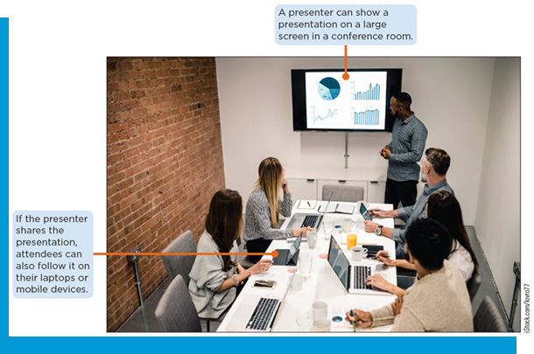
Presentation Software (5 of 6)
Design Effective Presentations
Organize with a beginning, middle, and end
Focus on one topic at a time
Choose appropriate backgrounds, colors, and fonts
Use graphics wisely
Use animations and transitions carefully
Use spelling and grammar checks

Slide 31
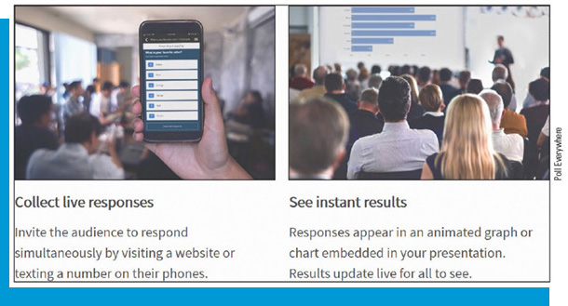
Presentation Software (6 of 6)
Deliver Effective Presentations
Check equipment in advance
Speak loudly and clearly
Don’t read the slides
Try not to stand behind a podium or in one place
Use technology to enhance your presentation
Involve the audience
Do a dry-run beforehand

Slide 32
Database Software (1 of 5)
A collection of data organized in a manner that allows access, retrieval, and reporting of that data
Add, update, and delete data
Filter, sort and retrieve data from the database
Create forms and reports
Database applications
Track contacts, schedules, possessions, or collections
Process orders, track inventory, maintain customer lists, or manage employee records
Store customer relationship management data
Represents a query in S Q L (Structured Query Language)

Slide 33
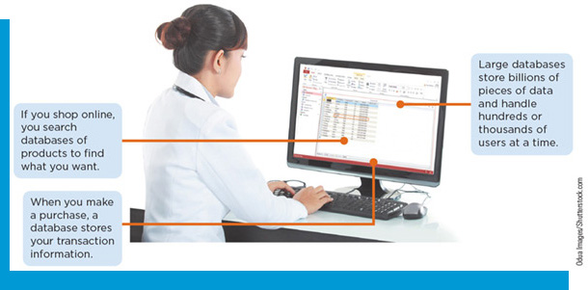
Database Software (2 of 5)
Because many users may need to access a database at the same time and they can be quite large, enterprise databases generally run on a server
Data can be exported into other programs, such as a spreadsheet program, where you can create charts to visualize data that results from a query
Data can be exported to other formats, including HTML, to publish to the web

Slide 34
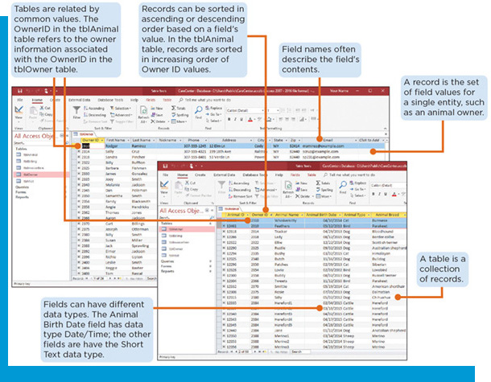
Database Software (3 of 5)
Relational database management system (R D B M S), or relational database: a database that consists of a collection of tables where items are organized in columns and rows
Microsoft Access
Data is organized into tables of records and stored electronically
The software displays commands and work areas appropriate to the view for your task
Big Data: data collections so large that it is difficult to process using relational database applications

Slide 35
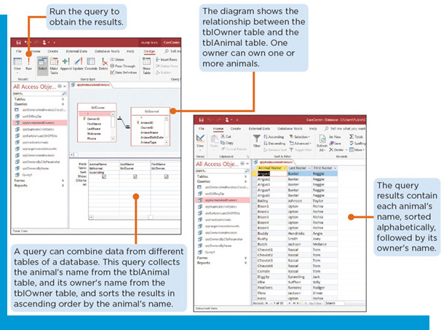
Database Software (4 of 5)
Each piece of data is entered and stored in a field
Each field is assigned a field name
Tables are a collection of records for a single subject
A query extracts data based on specified criteria, or conditions, for one or more fields
A report is a user-designed layout of database content
A form is a screen used to enter data into a database
A form is made up of controls

Slide 36
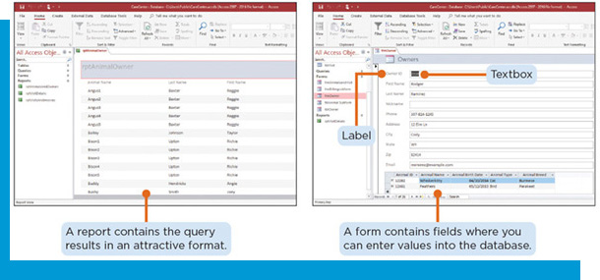
Database Software (5 of 5)
Manage Databases
Control access to the database by regulating who can use it and what parts they can see
Ensure data integrity and minimize data entry errors by controlling how data is entered, formatted, and stored
Prevent users from inadvertently changing or deleting important data
Control version issues
Manage database backup plans regularly
Establish security to protect data from hacker attacks

Slide 37
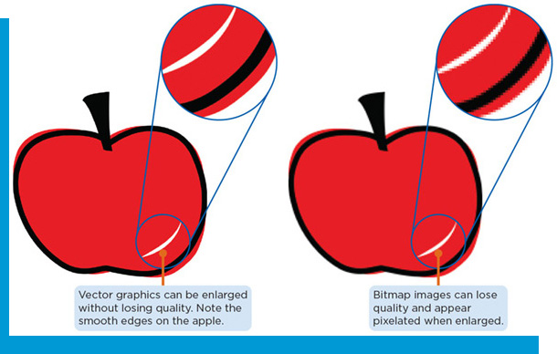
Graphics Software (1 of 4)
Create, view, manipulate, and print many types of digital images
Digital images are stored either in bitmap, sometimes called raster, or vector format
Bitmap images are based on pixels
Vector graphics use mathematical formulas to define their appearance
Most clip art images are stored as vector graphics

Slide 38
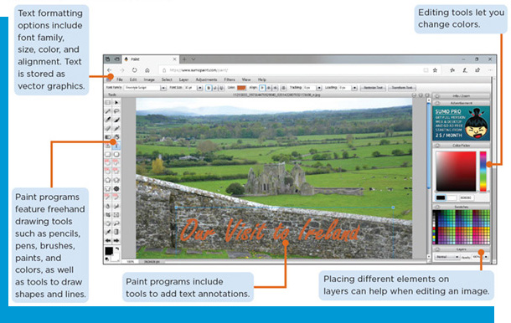
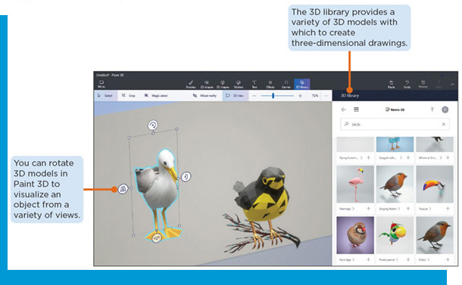
Graphics Software (2 of 4)
Key Features
Use a mouse or stylus to draw on the screen using a crayon, pencil, paintbrush, or calligraphy pen
Use shape tools to create lines, circles, rectangles, arrows, and callouts
Use color palettes to specify colors for shapes, lines, and borders
Add filters and effects to provide visual interest, and adjust brightness and contrast
Add text to graphics
Crop or resize an image

Slide 39
Graphics Software (3 of 4)
Table 5-11: Popular graphics formats
Name | Extension | Description
Bitmap | .bmp | Uncompressed file format that codes a value for each pixel. Files can be large.
T I F F (Tagged Image File Format) | .tiff | Large image format commonly used for print publishing because it maintains quality. Avoid using on webpages because of the large file sizes.
J P E G (Joint Photographic Experts Group) | .jpg | A compressed image file format usually used to save photos taken with digital cameras. Useful for images on webpages and in documents, because they have high quality and small file sizes.
G I F (Graphics Interchange Format) | .gif | A proprietary compressed graphics format that supports images with animation and transparent backgrounds.
P N G (Portable Networks Graphics) | .png | An open compressed format that has replaced GIF in many cases. Supports images with transparent backgrounds. Low resolution images that you can edit without losing quality. Great for use on webpages.
Raw data | .raw | Uncompressed and unprocessed data from a digital camera, Usually used by professional photographers.

Slide 40
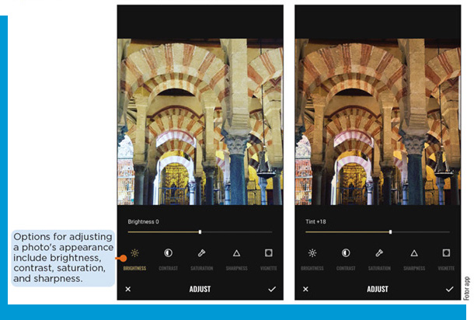
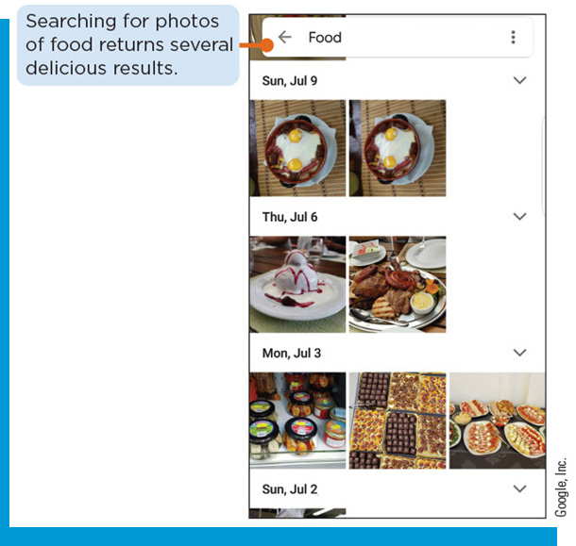
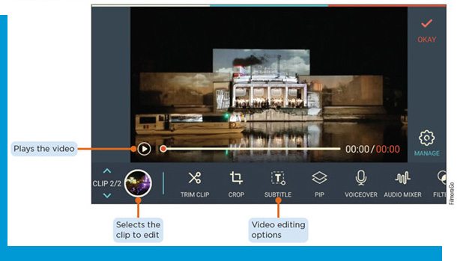
Graphics Software (4 of 4)
Types of Apps
Paint apps draw pictures, shapes, and other graphics with various on-screen tools
Photo and image editing apps provide the capabilities of paint apps and let you enhance and modify existing photos and images
Video editing apps allow you to modify a clip and typically include audio editing capabilities
Drawing apps let you create simple, two-dimensional images, typically vector graphics

